Slide 1





Comparing handwritten and AI-generated microbenchmarks for performance regression detection
Master's Degree in Computer Science
Prof. Dario Di Nucci Dott. Antonio Trovato
Oussama Boukhachem Mat.: 0522501392
o.boukhachem@studenti.unisa.it Github repository
@oussama-boukhachem
Get the thesis PDF file—>

Slide 2


Context & Motivation
What are Microbenchmarks?
Tests that measure the performance of tiny, isolated pieces of code (like a single Java method), rather than an entire software system.
To measure execution time or throughput at the microsecond or nanosecond level.
They act as a defense mechanism to catch performance regressions.
o.boukhachem@studenti.unisa.it Github repository
@oussama-boukhachem
Get the thesis PDF file—>

Slide 3
Context & Motivation
What are Microbenchmarks?
Tests that measure the performance of tiny, isolated pieces of code (like a single Java method), rather than an entire software system.
To measure execution time or throughput at the microsecond or nanosecond level.
They act as a defense mechanism to catch performance regressions.
Performance Regressions: Unintended slowdowns or memory degradations caused when a developer introduces new code into a project.
o.boukhachem@studenti.unisa.it Github repository
@oussama-boukhachem
Get the thesis PDF file—>

Slide 4
Context & Motivation
The Challenges of Microbenchmarking
Writing microbenchmarks manually is incredibly difficult due to the nature of modern Java Virtual Machines (JVMs)
o.boukhachem@studenti.unisa.it Github repository
@oussama-boukhachem
Get the thesis PDF file—>

Slide 5

Context & Motivation
The Challenges of Microbenchmarking
Writing microbenchmarks manually is incredibly difficult due to the nature of modern Java Virtual Machines (JVMs)
Warmup & Steady State
Java compilers (JIT) aggressively optimize code while it runs. Early executions are slow; later ones are fast. Finding the stable "steady state" to measure is complex.
o.boukhachem@studenti.unisa.it Github repository
@oussama-boukhachem
Get the thesis PDF file—>

Slide 6

Context & Motivation
The Challenges of Microbenchmarking
Writing microbenchmarks manually is incredibly difficult due to the nature of modern Java Virtual Machines (JVMs)
Dead Code Elimination
Modern compilers are very smart. If your benchmark calculates a value but doesn't print or return it, the compiler deletes the code to save time, giving fake "zero nanosecond" results.
o.boukhachem@studenti.unisa.it Github repository
@oussama-boukhachem
Get the thesis PDF file—>

Slide 7

Context & Motivation
The Challenges of Microbenchmarking
Writing microbenchmarks manually is incredibly difficult due to the nature of modern Java Virtual Machines (JVMs)
Environmental Noise
Background OS processes, CPU caching, and hyper-threading can easily corrupt the nanosecond measurements.
o.boukhachem@studenti.unisa.it Github repository
@oussama-boukhachem
Get the thesis PDF file—>

Slide 8

Context & Motivation
JMH Mechanics & The LLM Opportunity
The Standard Tool: Java Microbenchmark Harness (JMH)
o.boukhachem@studenti.unisa.it Github repository
@oussama-boukhachem
Get the thesis PDF file—>

Slide 9
Context & Motivation
JMH Mechanics & The LLM Opportunity
The Standard Tool: Java Microbenchmark Harness (JMH)
Warmup Iterations: JMH forces the code to run many times before measuring to ensure the steady state is reached.
o.boukhachem@studenti.unisa.it Github repository
@oussama-boukhachem
Get the thesis PDF file—>

Slide 10
Context & Motivation
JMH Mechanics & The LLM Opportunity
The Standard Tool: Java Microbenchmark Harness (JMH)
Warmup Iterations: JMH forces the code to run many times before measuring to ensure the steady state is reached.
The "Blackhole": A JMH tool that consumes outputs so the compiler cannot delete "dead code".
o.boukhachem@studenti.unisa.it Github repository
@oussama-boukhachem
Get the thesis PDF file—>

Slide 11
Context & Motivation
JMH Mechanics & The LLM Opportunity
The Standard Tool: Java Microbenchmark Harness (JMH)
Warmup Iterations: JMH forces the code to run many times before measuring to ensure the steady state is reached.
The "Blackhole": A JMH tool that consumes outputs so the compiler cannot delete "dead code".
JVM Forking: Spawns completely new Virtual Machines for different tests to isolate memory.
o.boukhachem@studenti.unisa.it Github repository
@oussama-boukhachem
Get the thesis PDF file—>

Slide 12

Context & Motivation
The Challenge: Writing good microbenchmarks is highly complex, time-consuming, and prone to measurement errors.
o.boukhachem@studenti.unisa.it Github repository
@oussama-boukhachem
Get the thesis PDF file—>

Slide 13

Context & Motivation
The Challenge: Writing good microbenchmarks is highly complex, time-consuming, and prone to measurement errors.
The Opportunity Large Language Models (LLMs) can generate code rapidly.
o.boukhachem@studenti.unisa.it Github repository
@oussama-boukhachem
Get the thesis PDF file—>

Slide 14
Context & Motivation
But can we trust AI-generated tests for precise performance measurements?
o.boukhachem@studenti.unisa.it Github repository
@oussama-boukhachem
Get the thesis PDF file—>

Slide 15
Objective and Case Study
Main Goal Statistically compare the efficacy of Human-Written vs AI-Generated microbenchmarks in detecting performance regressions.
o.boukhachem@studenti.unisa.it Github repository
@oussama-boukhachem
Get the thesis PDF file—>

Slide 16

Objective and Case Study
Main Goal Statistically compare the efficacy of Human-Written vs AI-Generated microbenchmarks in detecting performance regressions.
Subject System Apache Ignite (a popular, highly concurrent distributed database).
o.boukhachem@studenti.unisa.it Github repository
@oussama-boukhachem
Get the thesis PDF file—>

Slide 17
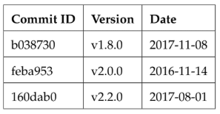
Objective and Case Study
Evaluated Versions: 3 historical commits (v1.8.0, v2.0.0, v2.2.0).
o.boukhachem@studenti.unisa.it Github repository
@oussama-boukhachem
Get the thesis PDF file—>

Slide 18
Objective and Case Study
Evaluated Versions: 3 historical commits (v1.8.0, v2.0.0, v2.2.0).
2 benchmarks 7 benchmarks 7 benchmarks
Dataset 32 benchmarks in total 16 original Human-written benchmarks. 16 equivalent AI-generated twin benchmarks.
o.boukhachem@studenti.unisa.it Github repository
@oussama-boukhachem
Get the thesis PDF file—>

Slide 19
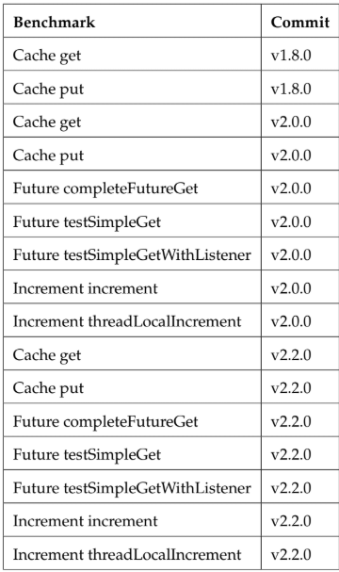
Objective and Case Study
Benchmarks
o.boukhachem@studenti.unisa.it Github repository
@oussama-boukhachem
Get the thesis PDF file—>

Slide 20
Prompt Engineering & AI Benchmark Generation
Approach " GPT-4 Functional Equivalence" but strict "Code Independence."
o.boukhachem@studenti.unisa.it Github repository
@oussama-boukhachem
Get the thesis PDF file—>

Slide 21
Prompt Engineering & AI Benchmark Generation
Approach " GPT-4 Functional Equivalence" but strict "Code Independence."
Persona prompting Consists of assigning the AI model a specific professional identity before giving it a task.
o.boukhachem@studenti.unisa.it Github repository
@oussama-boukhachem
Get the thesis PDF file—>

Slide 22
Prompt Engineering & AI Benchmark Generation
Approach " GPT-4 Functional Equivalence" but strict "Code Independence."
Persona prompting Consists of assigning the AI model a specific professional identity before giving it a task.
Few-shot prompting Involves providing the model with the original handwritten benchmark as a concrete example
o.boukhachem@studenti.unisa.it Github repository
@oussama-boukhachem
Get the thesis PDF file—>

Slide 23
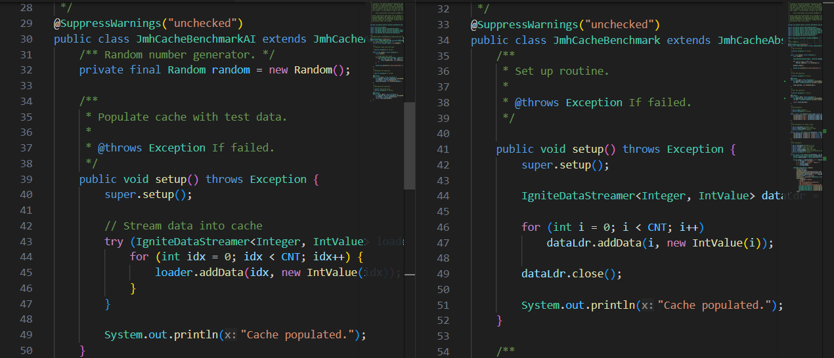
Prompt Engineering & AI Benchmark Generation
Results 16 perfectly compiling AI twins that test identical operations (Cache, Async/Futures, Atomic Increments) with different implementations.
o.boukhachem@studenti.unisa.it Github repository
@oussama-boukhachem
Get the thesis PDF file—>

Slide 24
Experimental Setup
A Rigorous Benchmarking Environment
Dedicated Server, 128GB RAM, 7 CPUs (Ubuntu 24.04).
Noise Reduction: Disabled system features like Turbo Boost and Hyper-Threading to ensure flat CPU performance.
10 JVM Forks per benchmark. 3000 Iterations per fork. Single-shot execution mode (recording time-per-operation to preserve full distribution data)
Execution Parameters:
o.boukhachem@studenti.unisa.it Github repository
@oussama-boukhachem
Get the thesis PDF file—>

Slide 25
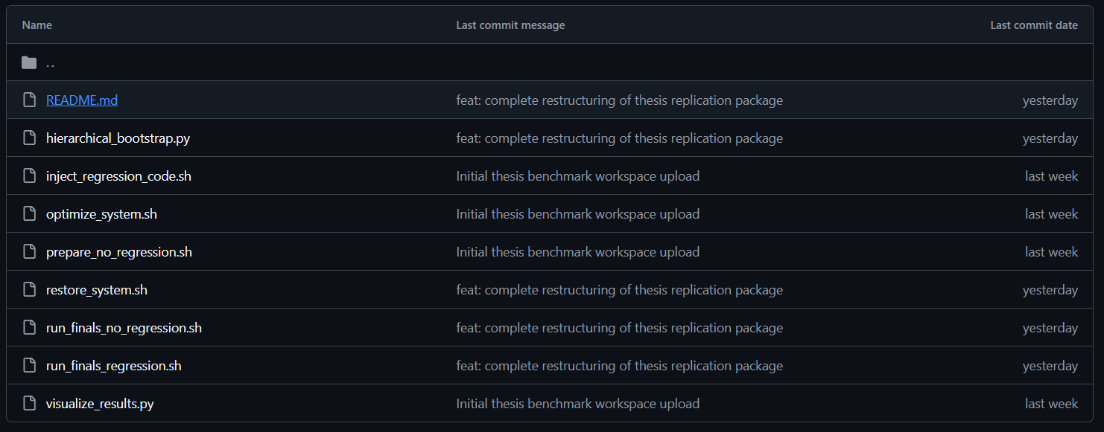
Experimental Setup
A Rigorous Benchmarking Environment
o.boukhachem@studenti.unisa.it Github repository
@oussama-boukhachem
Get the thesis PDF file—>

Slide 26
Injecting the Regression
Simulating Software Degradation
How do we guarantee a controlled, measurable regression?
o.boukhachem@studenti.unisa.it Github repository
@oussama-boukhachem
Get the thesis PDF file—>

Slide 27
Injecting the Regression
Simulating Software Degradation
How do we guarantee a controlled, measurable regression?
The Solution: Artificial Code Injection
Injected Blackhole.consumeCPU(1000000L) into both Human and AI benchmark methods.
o.boukhachem@studenti.unisa.it Github repository
@oussama-boukhachem
Get the thesis PDF file—>

Slide 28
Injecting the Regression
Simulating Software Degradation
Phase 1 (Baseline): Tracked performance on clean code.
Phase 2 (Regression): Tracked performance after injecting the CPU delay.
o.boukhachem@studenti.unisa.it Github repository
@oussama-boukhachem
Get the thesis PDF file—>

Slide 29
Statistical Analysis
Evaluating the Data: Hierarchical Bootstrap
Solution
JMH execution data is non-independent (iterations inside the same JVM fork share the same memory state).
Standard statistical tests (like the t-test) would yield false positives.
o.boukhachem@studenti.unisa.it Github repository
@oussama-boukhachem
Get the thesis PDF file—>

Slide 30
Statistical Analysis
Evaluating the Data: Hierarchical Bootstrap
Solution
10,000 resampling iterations (first at the fork level, then at the iteration level) to calculate accurate 95% Confidence Intervals and p-values.
Used Hierarchical Bootstrapping.
o.boukhachem@studenti.unisa.it Github repository
@oussama-boukhachem
Get the thesis PDF file—>

Slide 31
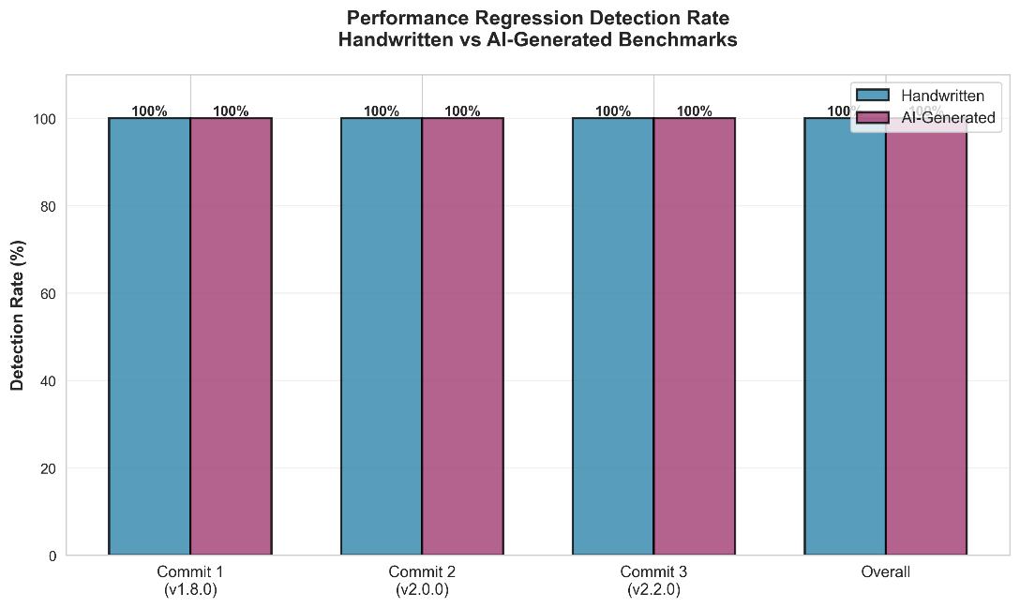
Key Findings (Detection Rate)
Finding 1: Regression Detection Success Rate
Handwritten: Successfully detected the regression 16 out of 16 times (100%).
AI-Generated: Successfully detected the regression 16 out of 16 times (100%).
Statistical significance achieved (p < 0.001) in all cases.
o.boukhachem@studenti.unisa.it Github repository
@oussama-boukhachem
Get the thesis PDF file—>

Slide 32

Key Findings (Detection Rate)
Finding 1: Regression Detection Success Rate
Answer to RQ1. AI-generated benchmarks are fully equivalent to hand-written ones in terms of detection capability.
o.boukhachem@studenti.unisa.it Github repository
@oussama-boukhachem
Get the thesis PDF file—>

Slide 33
Key Findings (Behavioral Equivalence)
Finding 2: Measurement Sensitivity
When comparing the median impact across all benchmarks per commit, AI-generated benchmarks report a higher value in all three versions:
v1.8.0 the AI median is 4,777% versus 4,447%
v2.0.0 the AI median is 63,400% versus 61,887%
v2.2.0 the AI median is 69,838% versus 61,417%
Answer to RQ2. While the advantage is not uniform at the per-benchmark level, the overall signal produced by AI-generated benchmarks is consistently at least as strong as, and at the median level larger than, the handwritten baselines.
o.boukhachem@studenti.unisa.it Github repository
@oussama-boukhachem
Get the thesis PDF file—>

Slide 34
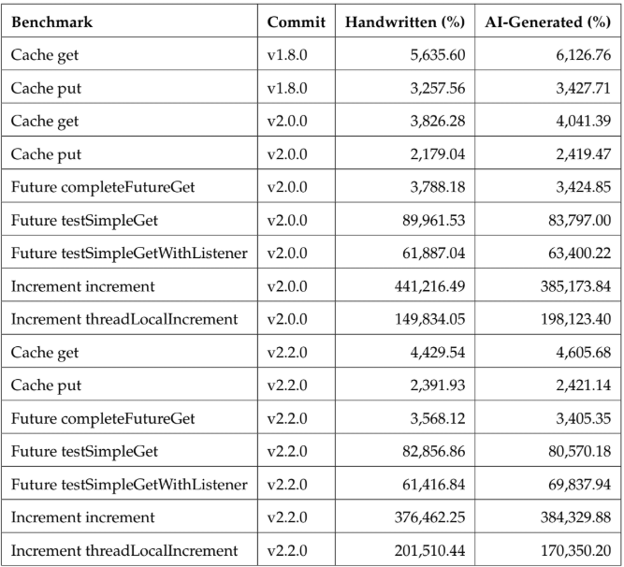
Key Findings (Behavioral Equivalence)
Finding 2: Measurement Sensitivity
o.boukhachem@studenti.unisa.it Github repository
@oussama-boukhachem
Get the thesis PDF file—>

Slide 35
Key Findings (Behavioral Equivalence)
Finding 3: Generalization and Consistency
Benchmarks grouped by functionality: Cache, Async/Futures, and Atomic Increments.
The variance and standard deviation of AI benchmarks tightly mathematically mirror the handwritten code.
LLMs correctly preserved the scale and scope of the tested methods.
Answer to RQ3. AI-generated benchmarks generalize well: their detection capability and measurement sensitivity are stable across the full experimental scope of this study.
o.boukhachem@studenti.unisa.it Github repository
@oussama-boukhachem
Get the thesis PDF file—>

Slide 36
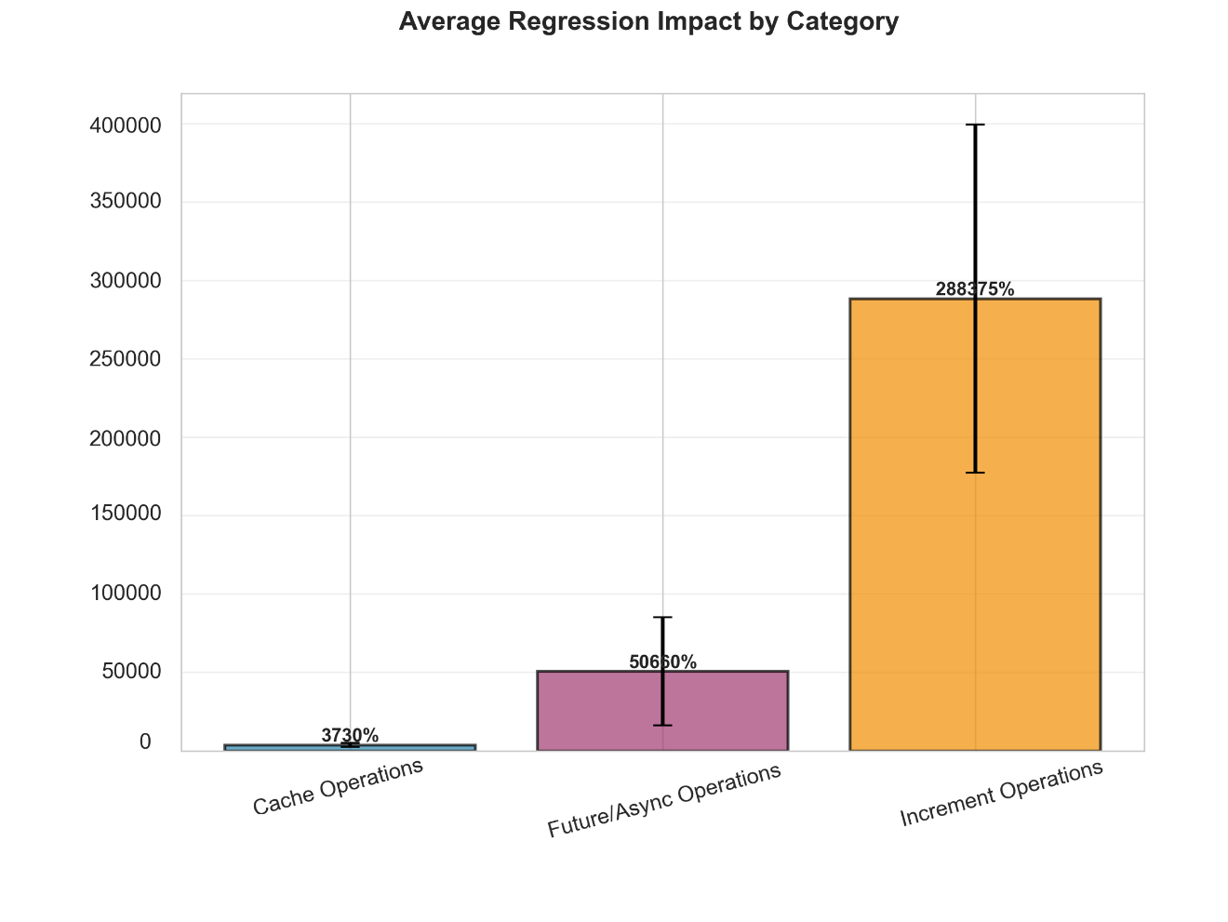
Key Findings (Behavioral Equivalence)
Finding 3: Generalization and Consistency
o.boukhachem@studenti.unisa.it Github repository
@oussama-boukhachem
Get the thesis PDF file—>

Slide 37
Threats to Validity
Limitations and Threats to Validity
Single Project: The study evaluates Apache Ignite. Other projects might differently challenge an LLM.
Artificial Regressions: Blackhole.consumeCPU() is a synthetic CPU stressor, not a semantic memory leak or algorithmic logical bug.
Generative constraints: We provided a high-quality prompt, which implies the AI still requires good developer directions to work this well.
o.boukhachem@studenti.unisa.it Github repository
@oussama-boukhachem
Get the thesis PDF file—>

Slide 38
Conclusions and Future Work
Conclusion: AI-generated JMH microbenchmarks are statistically just as effective as human-written ones for regression detection in complex systems.
Contribution: This work provides an open-source evaluation methodology, proving that LLMs can drastically reduce the cost of creating performance tracking infrastructures.
Future Work: Testing on other software domains. Evaluating natural regressions instead of synthetic injections. Link the automation with AMBER
o.boukhachem@studenti.unisa.it Github repository
@oussama-boukhachem
Get the thesis PDF file—>

Slide 39
Context
Comparing handwritten and AI-generated microbenchmarks for performance regression detection
THANK YOU !
o.boukhachem@studenti.unisa.it Github repository
@oussama-boukhachem
Get the thesis PDF file—>

